Slide 1

GOOD READS
Submitted to: Dr Parminder Kaur
Assistant Professor
Submitted by: Naiya Sharma
2014CSC1072
GURU NANAK DEV UNIVERSITY

Slide 2
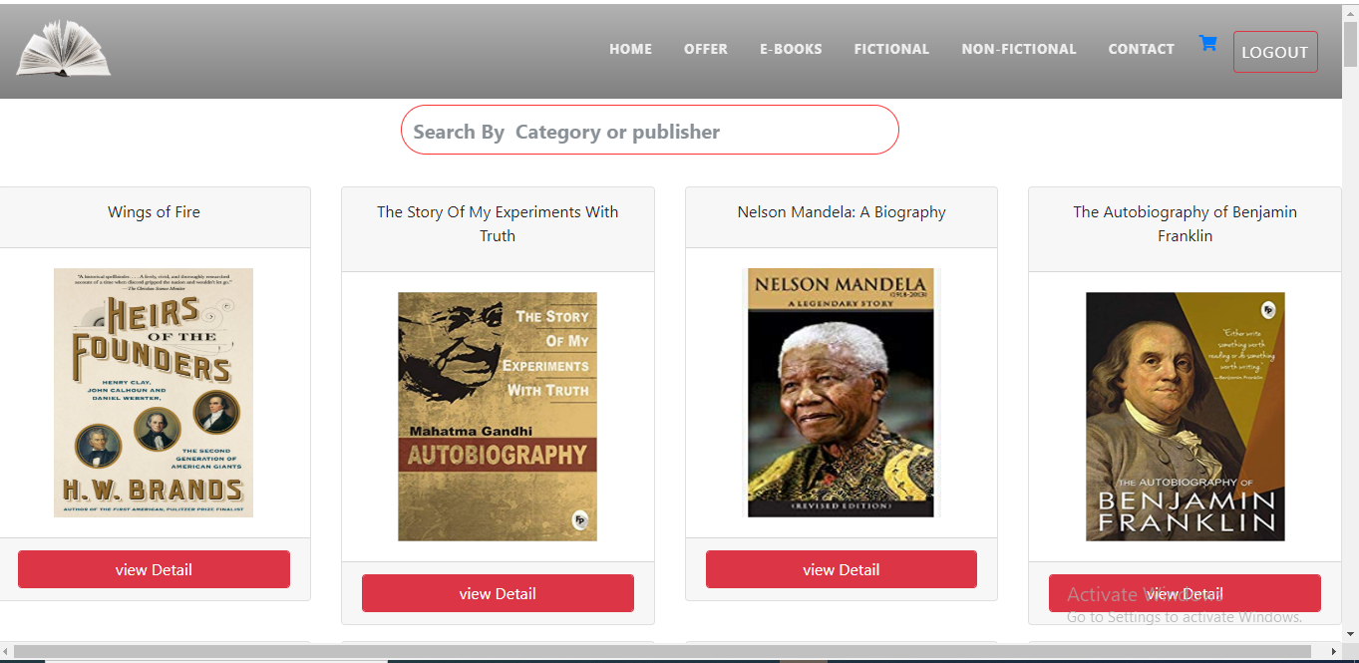
HOME PAGE

Slide 3
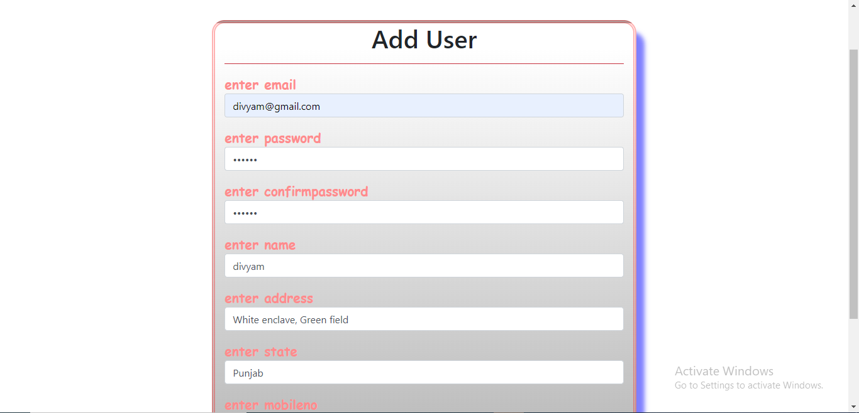
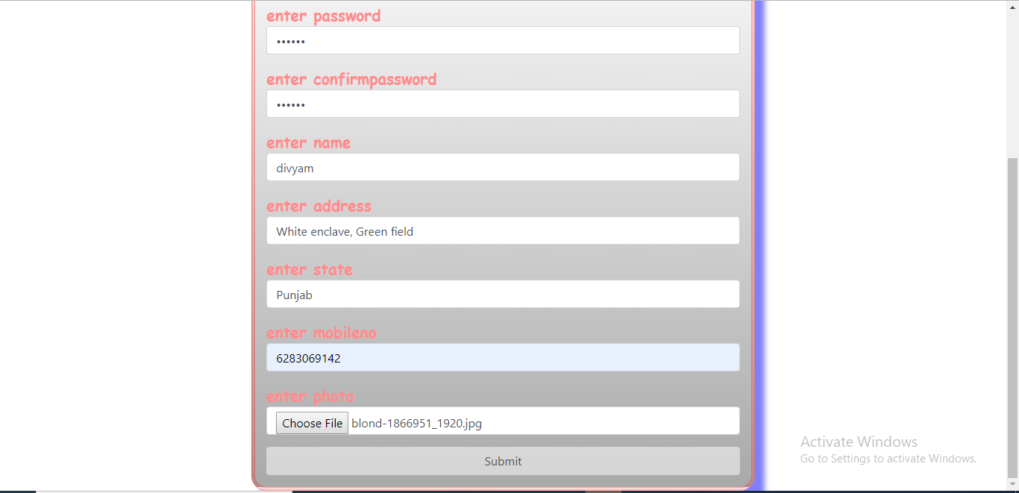
Add USER

Slide 4
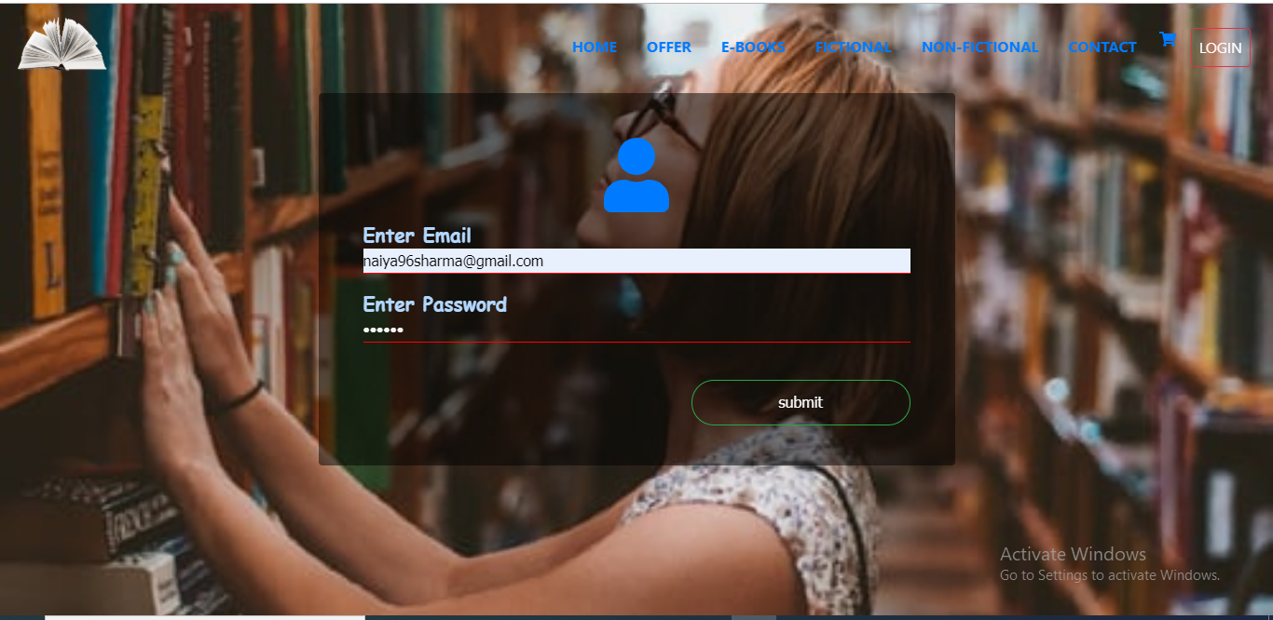
USER LOGIN

Slide 5
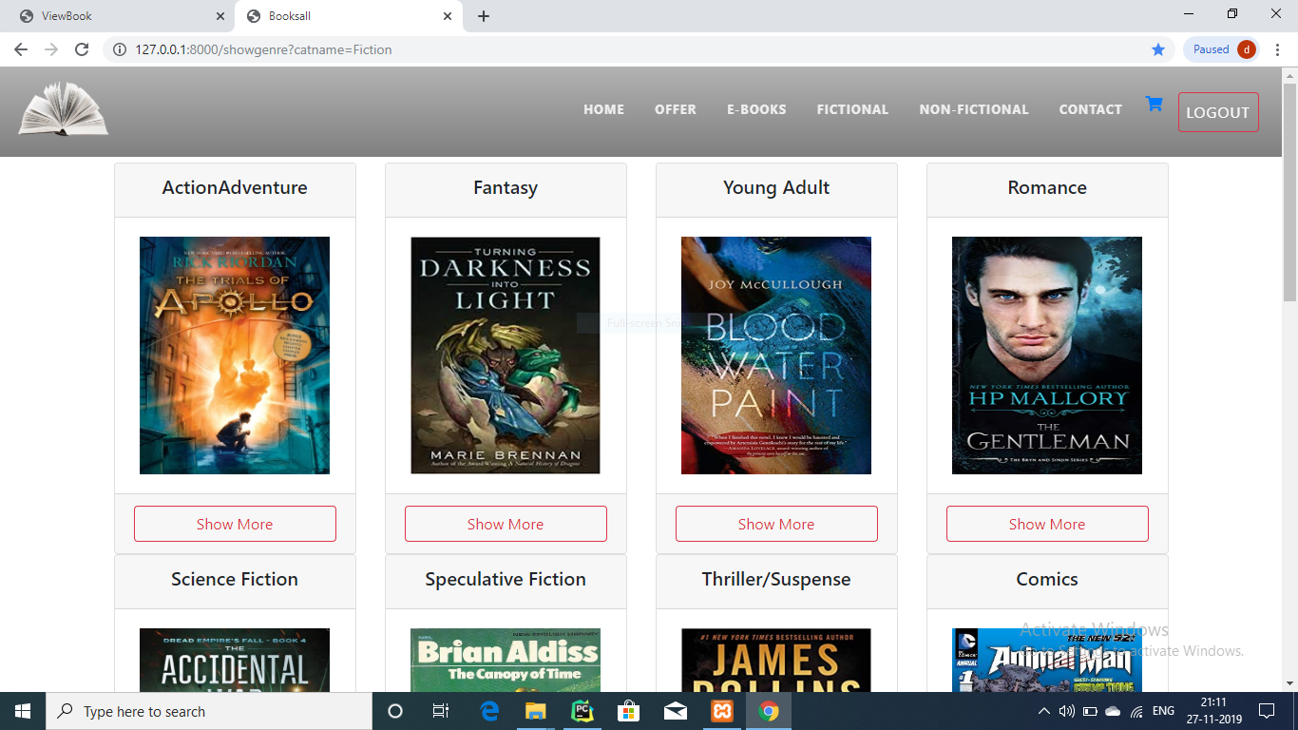
FICTION

Slide 6
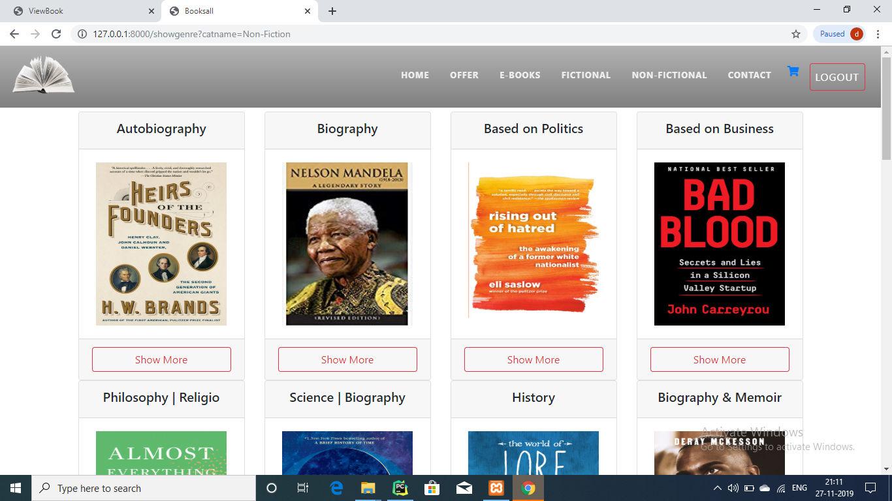
NON-FICTION

Slide 7
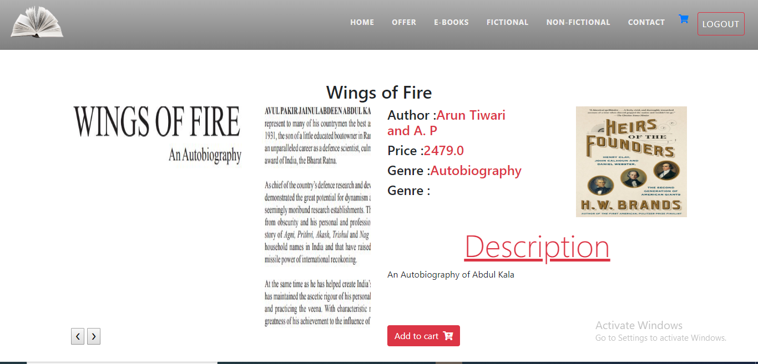
SAMPLE BOOK

Slide 8
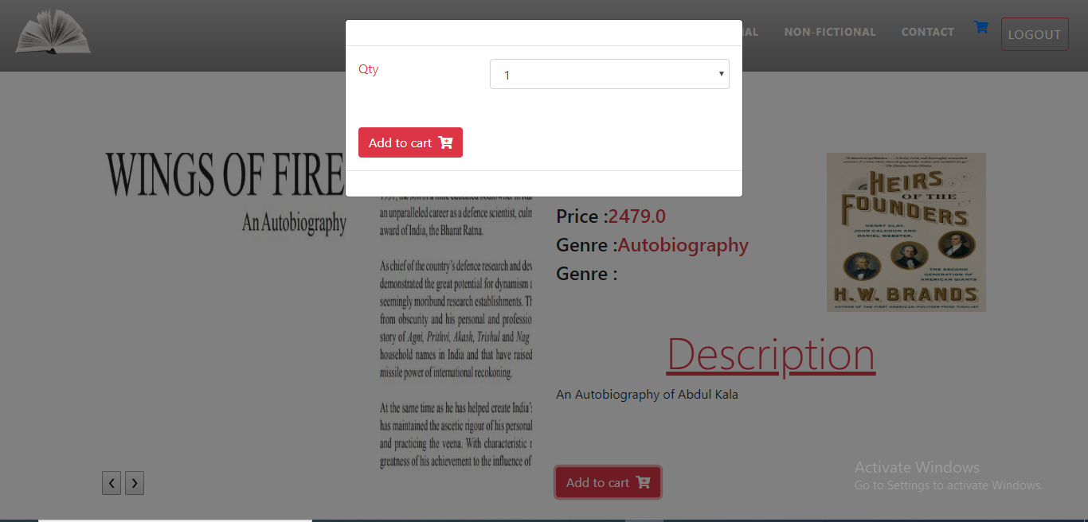
ADD TO CART

Slide 9
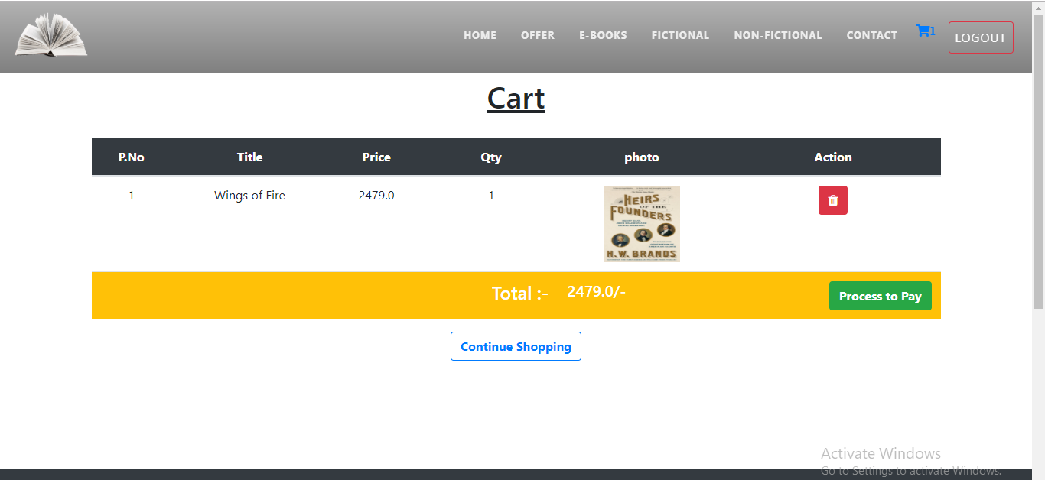
CART

Slide 10
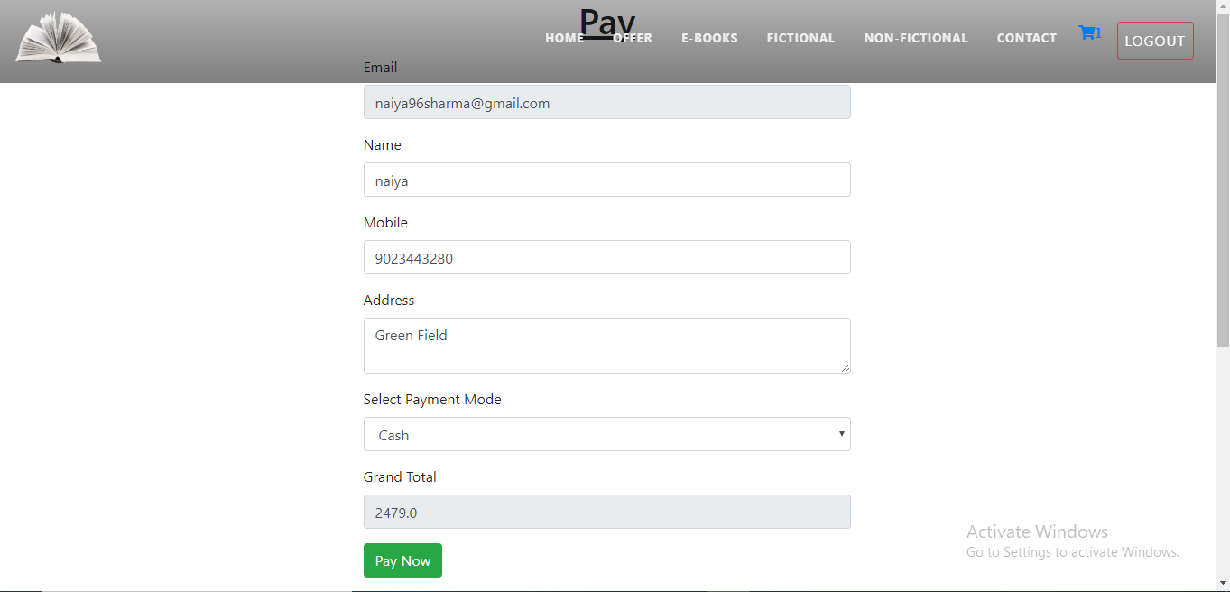
PAYMENT

Slide 11
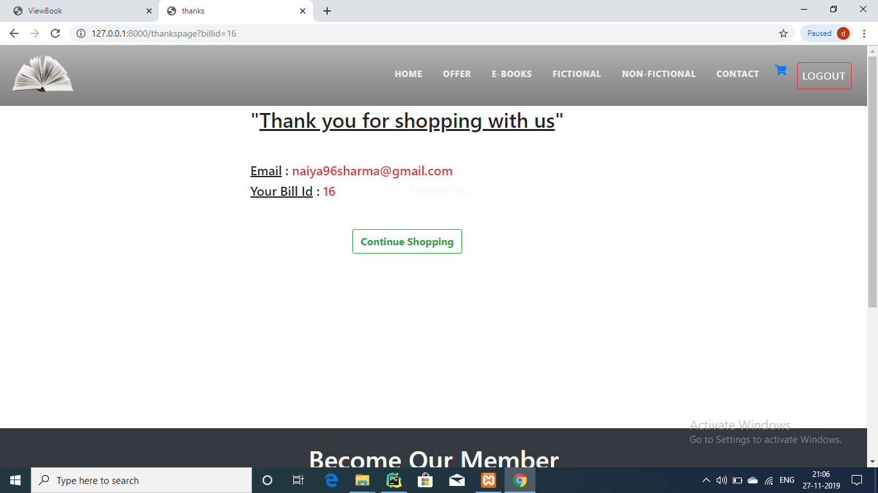
THANKS FOR SHOPPING

Slide 12
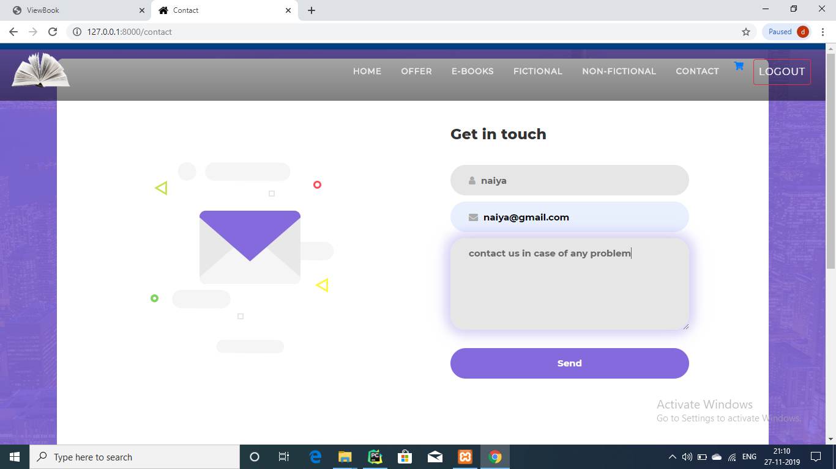
CONTACT

Slide 13
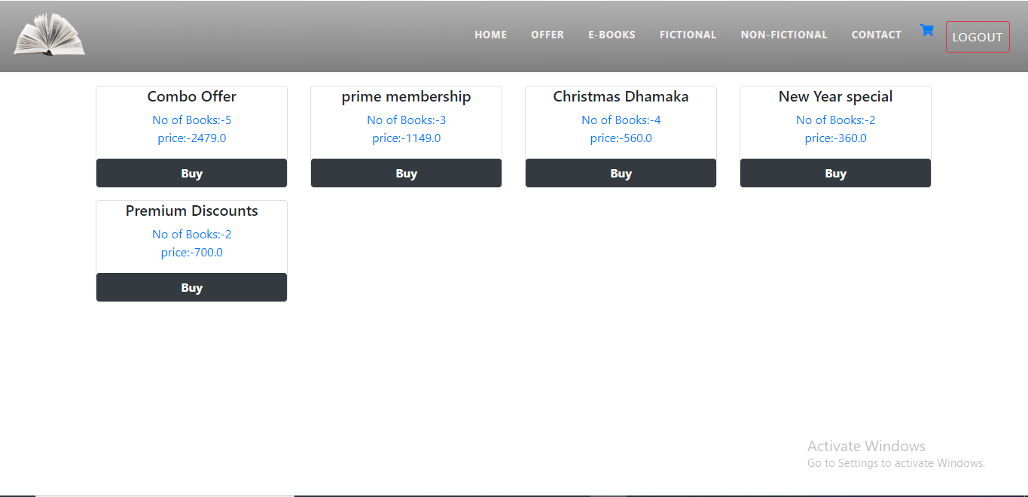
OFFERS

Slide 14
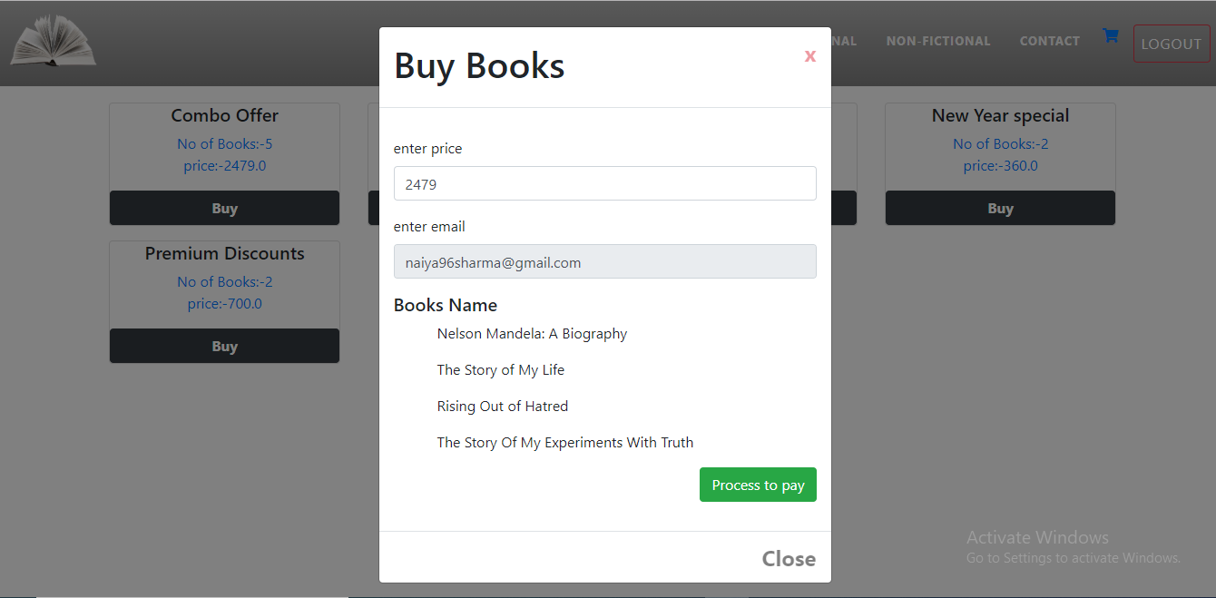
BUY BOOKS

Slide 15
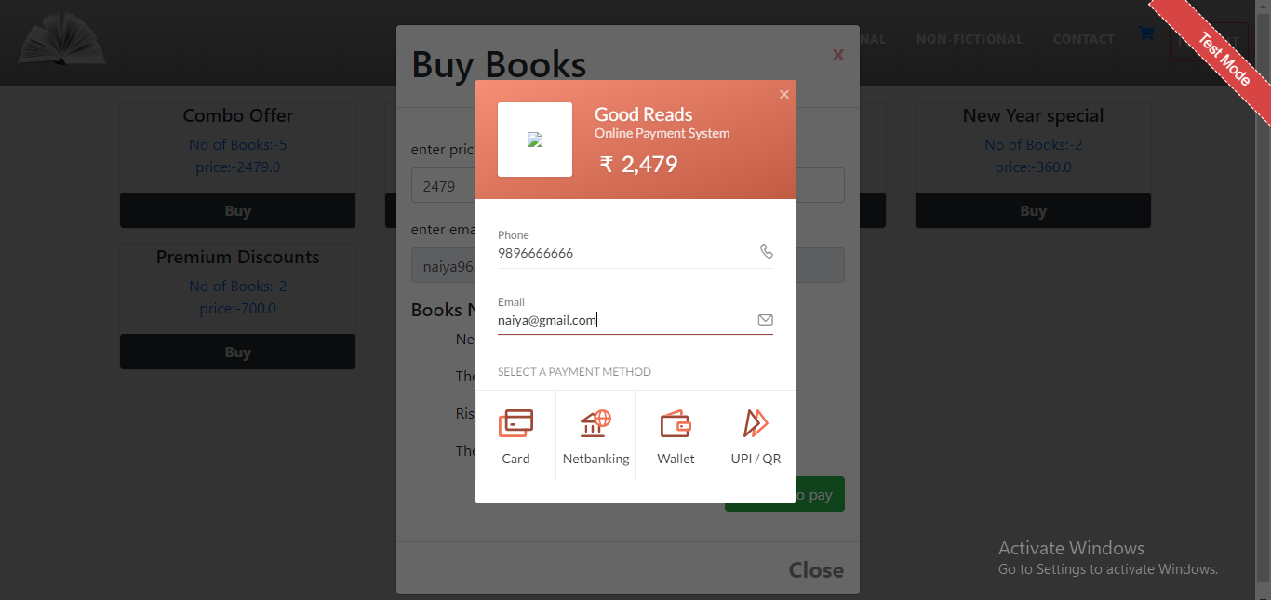
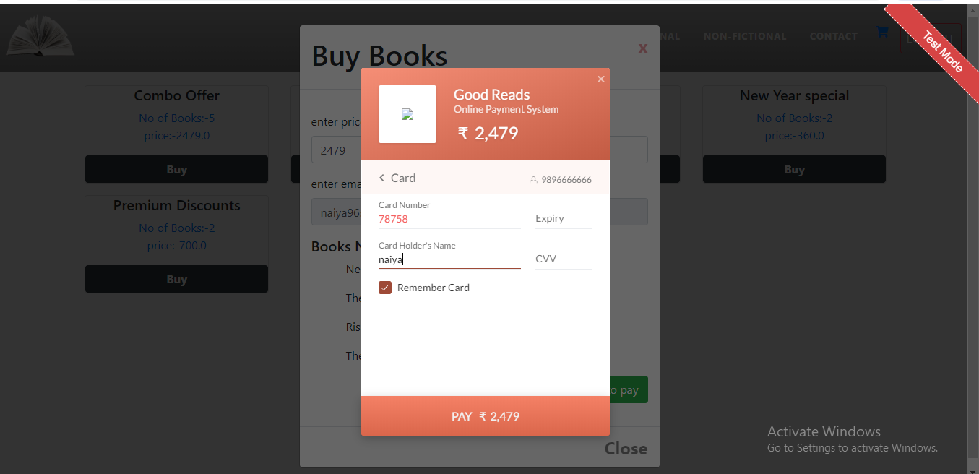
PAYMENT

Slide 16
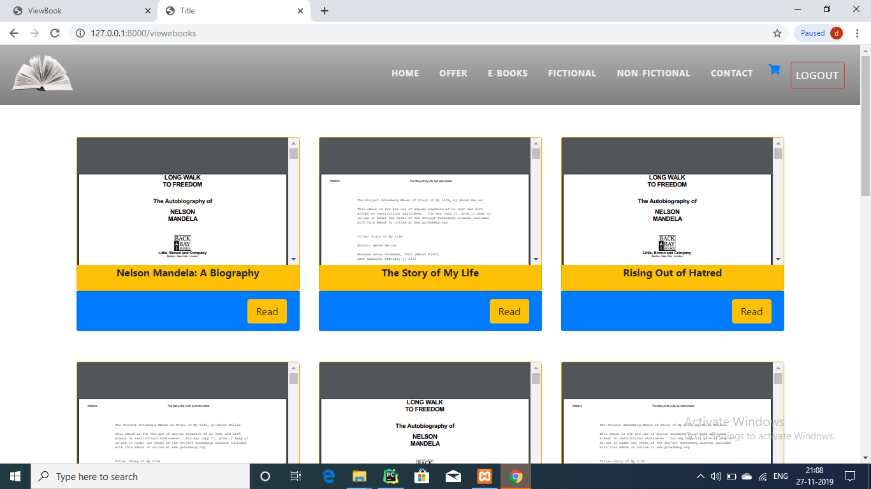
E-BOOKS

Slide 17

VIEW E-BOOKS

Slide 18
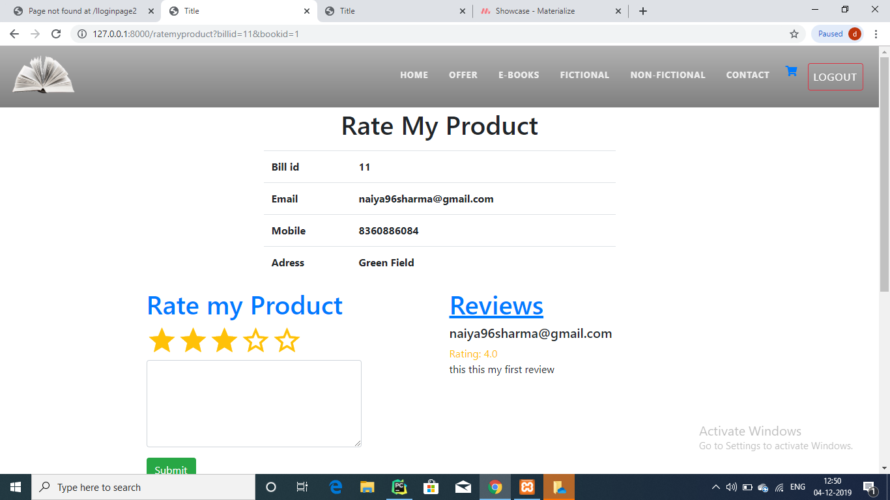
RATE MY PRODUCT

Slide 19
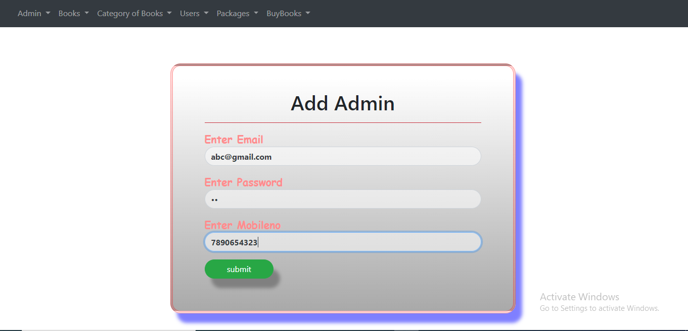
ADD ADMIN

Slide 20
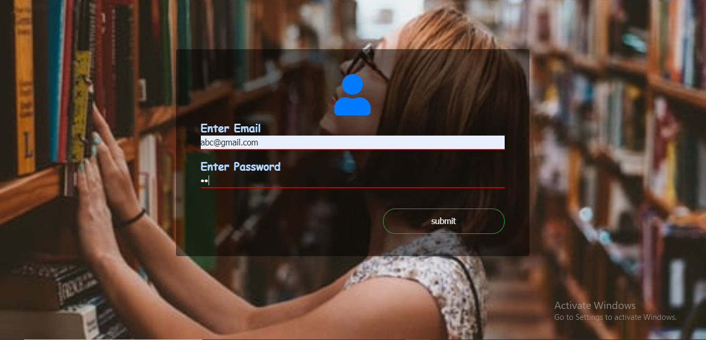
ADMIN-LOGIN

Slide 21
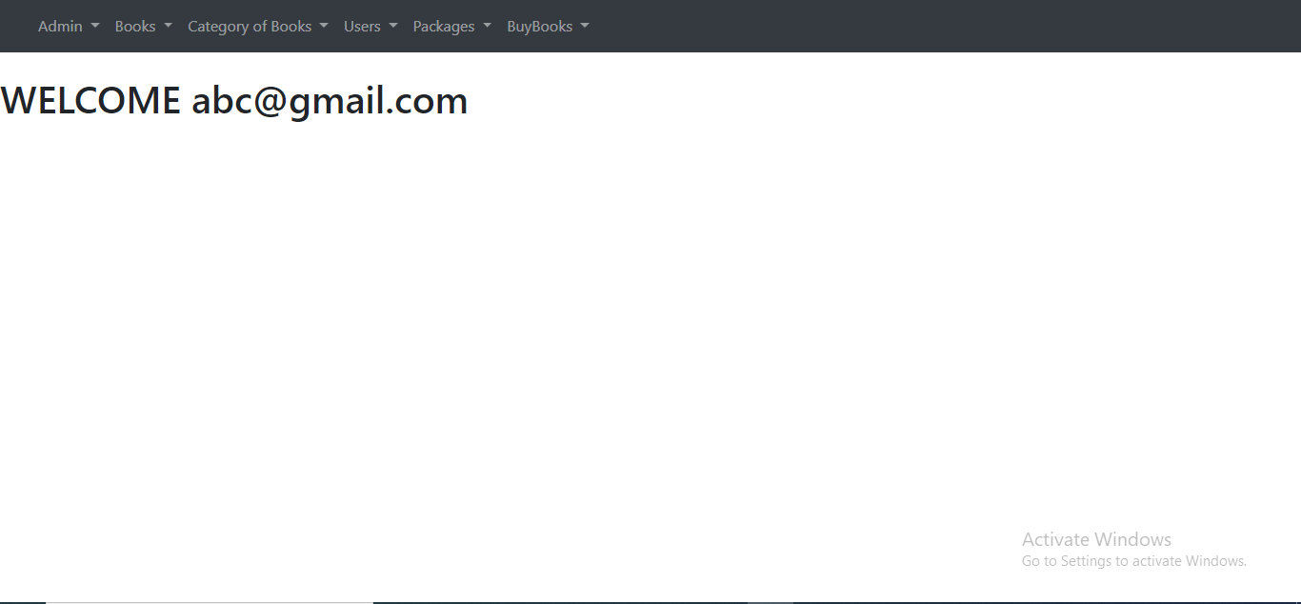
ADMIN DASHBOARD

Slide 22
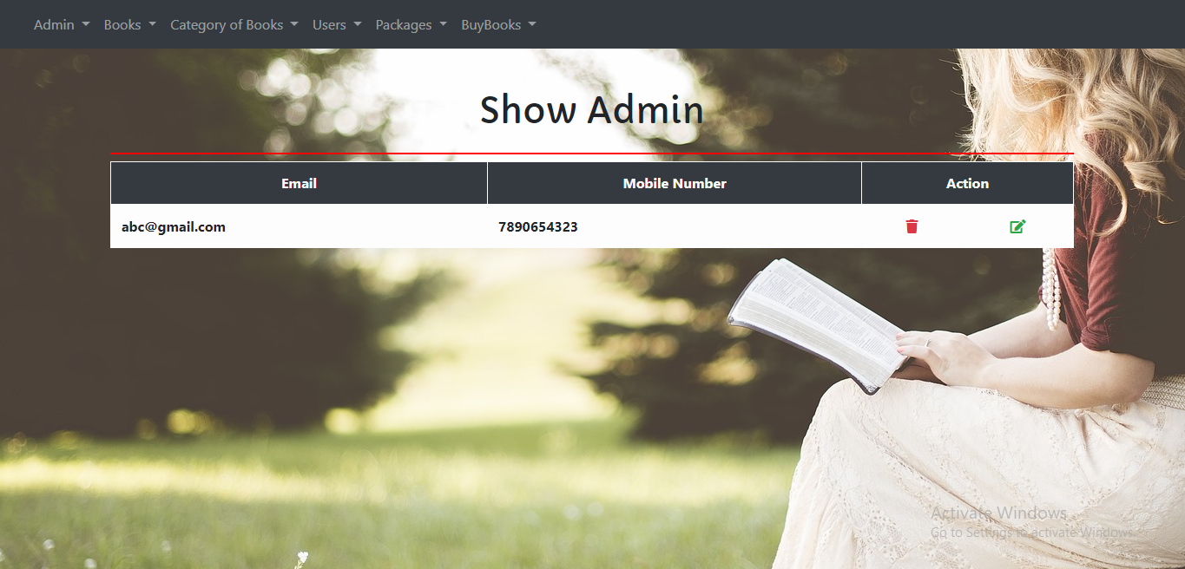
SHOW ADMIN

Slide 23
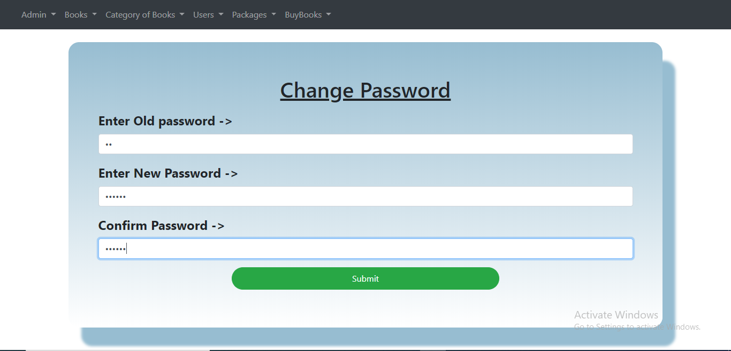
CHANGE PASSWORD

Slide 24
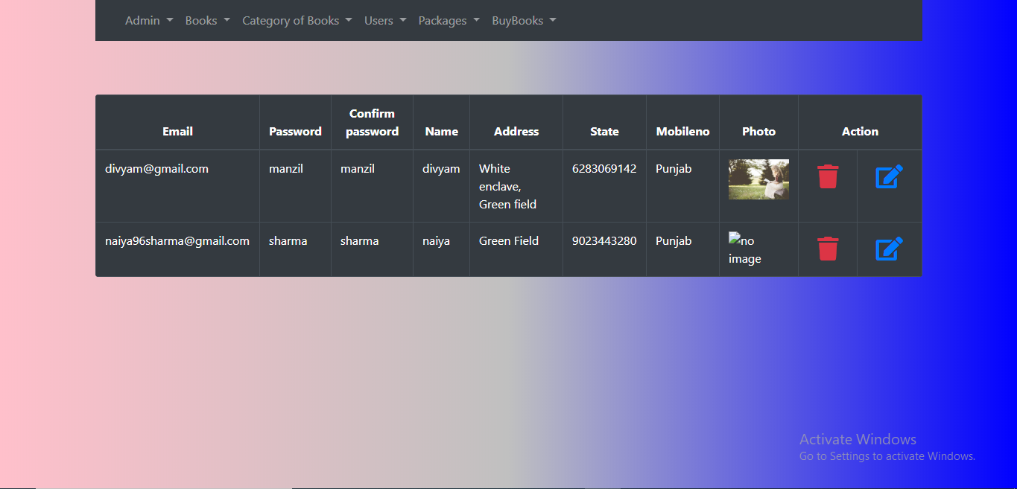
VIEW USER

Slide 25
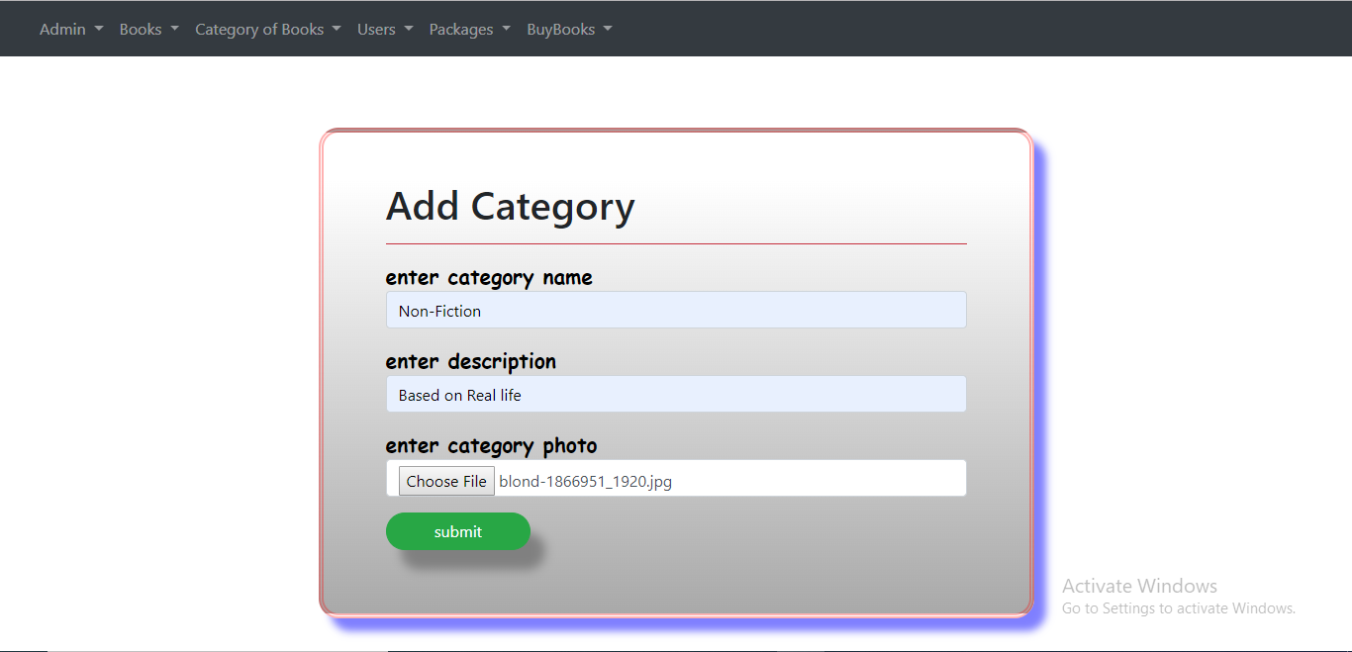
ADD CATEGORY

Slide 26
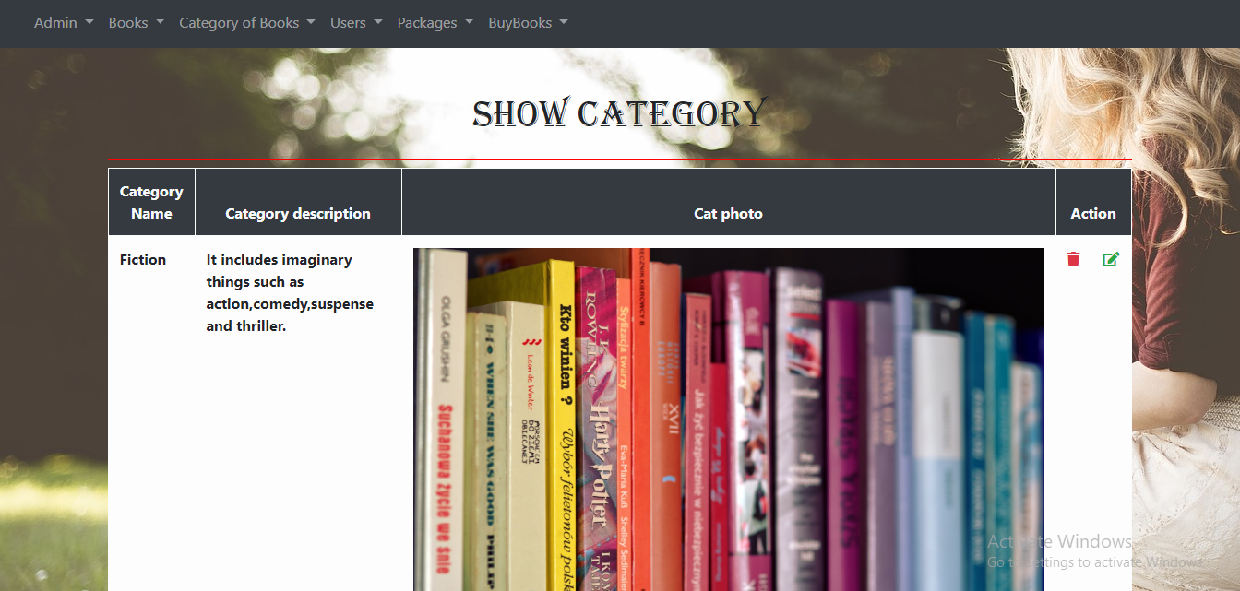

Slide 27
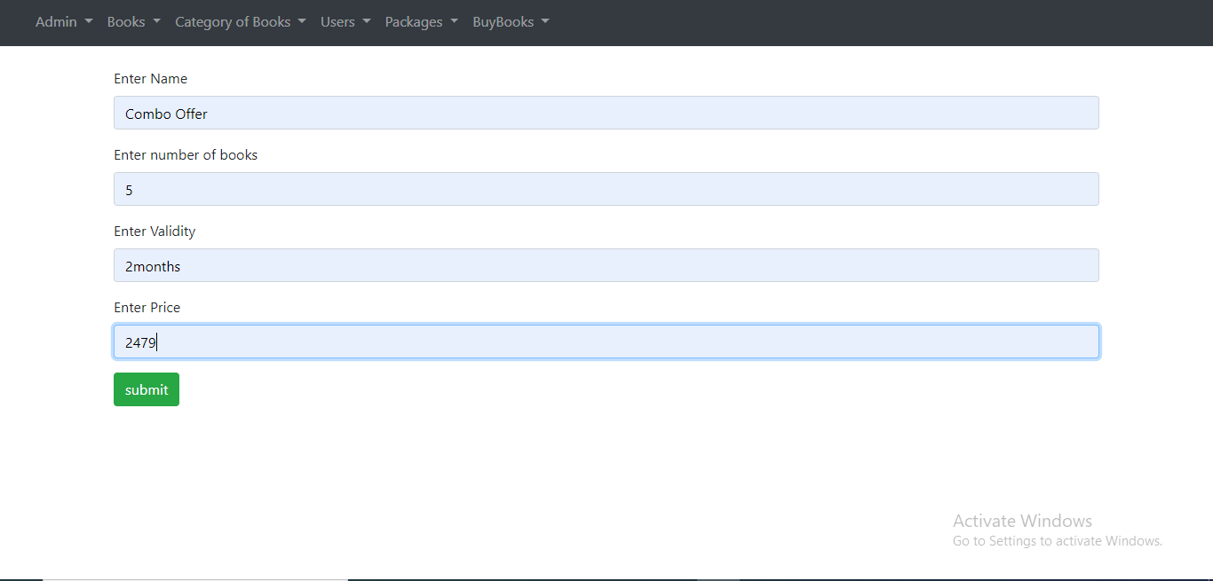
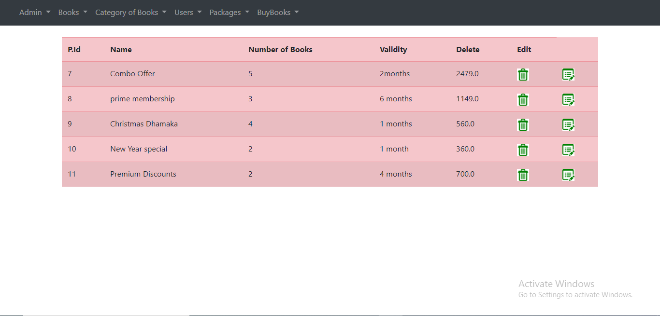
ADD & VIEW OFFER

Slide 28
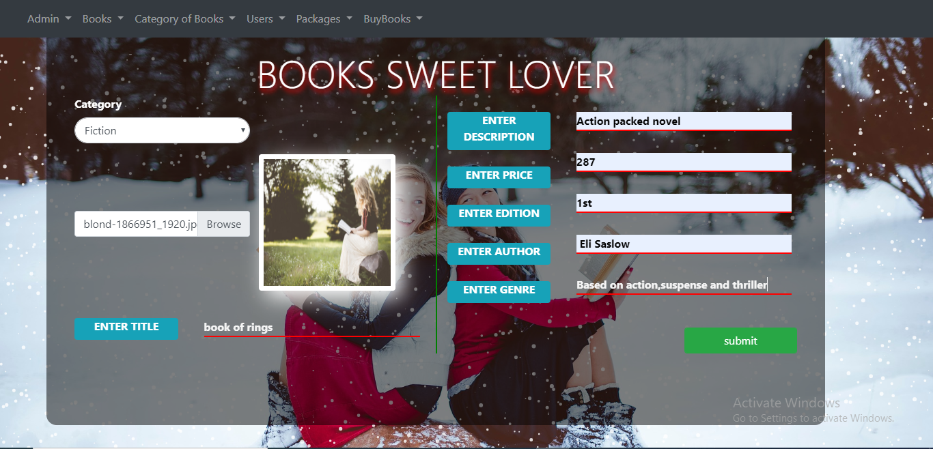
ADD BOOK

Slide 29
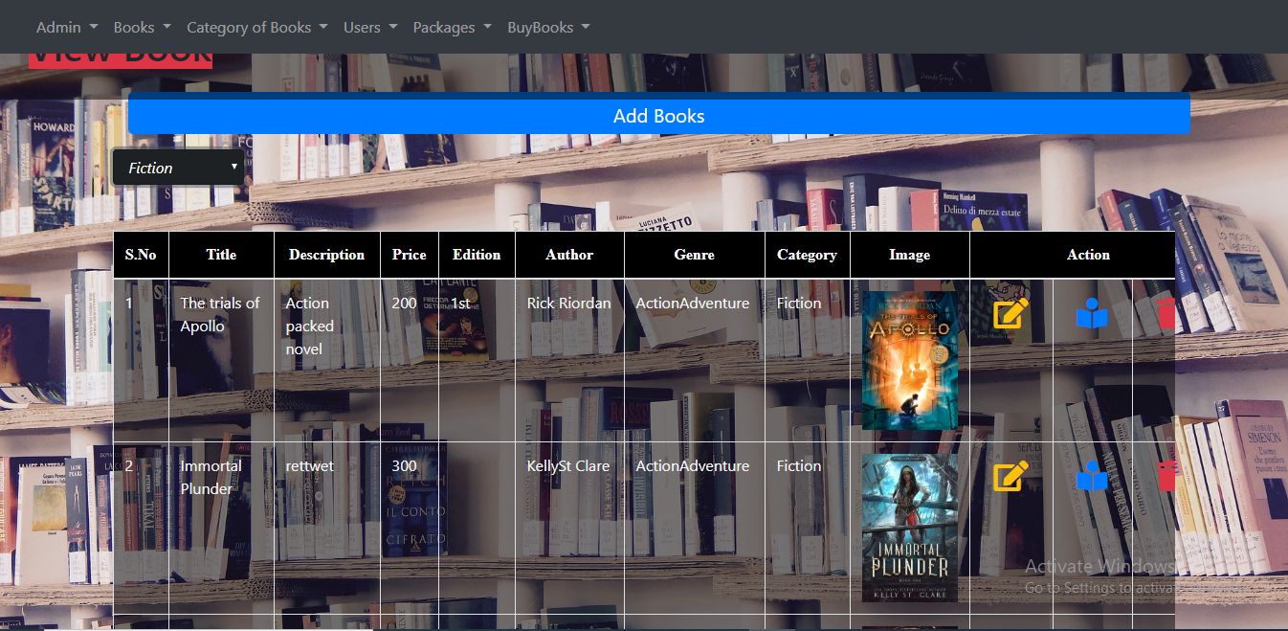
VIEW BOOK

Slide 30
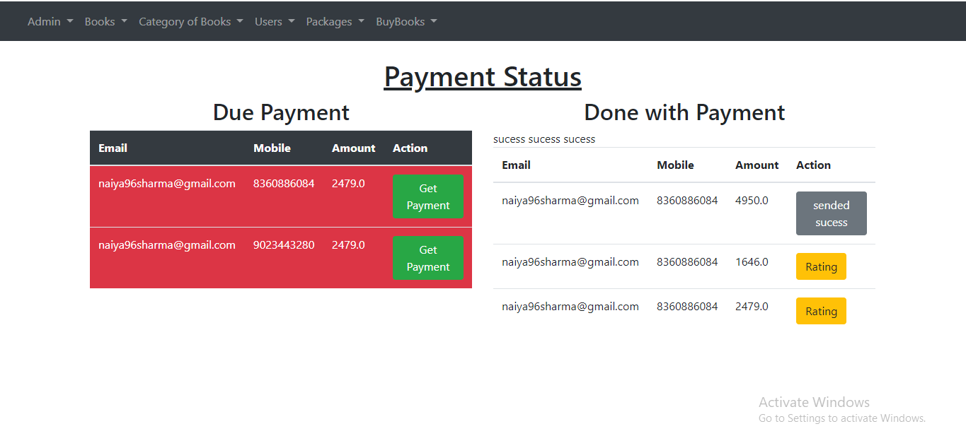
PAYMENT STATUS

Slide 31


